Slide 1

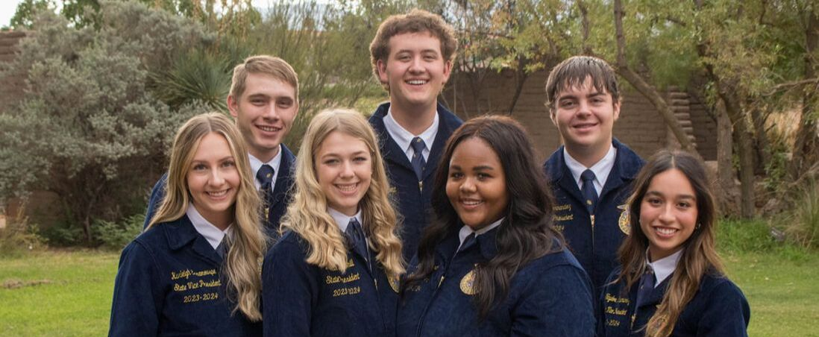
NMFFA State Officer Candidate Training

Slide 2
Expectations
Leave with a better understanding of the Nominating Committee Process
Understand the expectations of a state officer
Leave with confidence in their ability to go through nominating committee

Slide 3
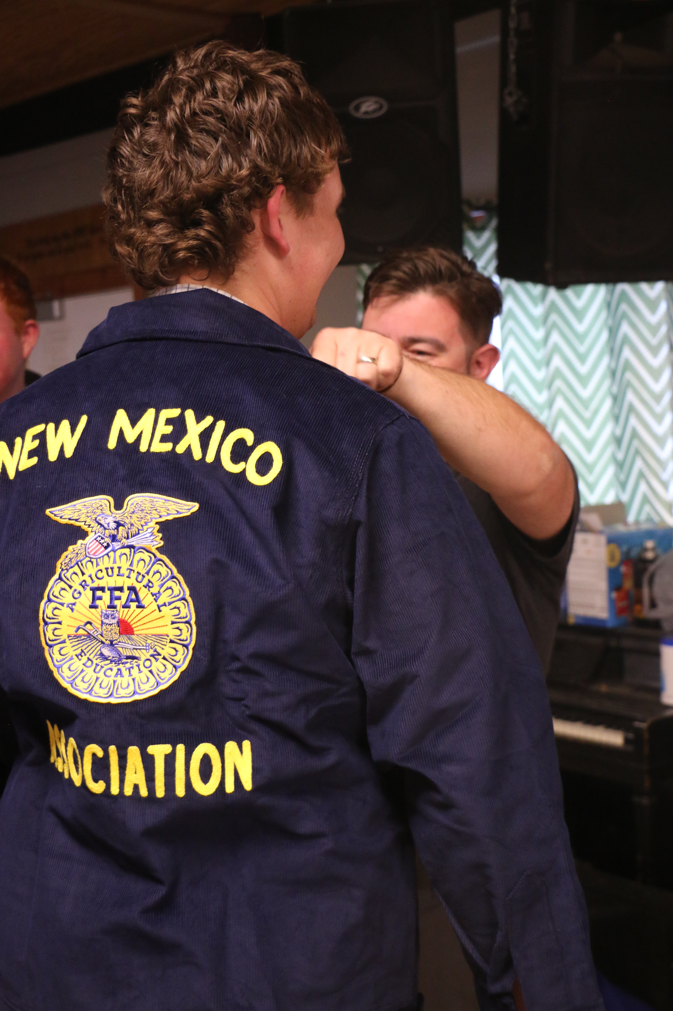
Introductions!!
Name
Chapter
Why do you want to be a state officer or nom com member?
Notes:
After this do characteristics of a state officer and then “what fears?” and “what do you want to learn” flipcharts

Slide 4
Commitments of a State Officer/Application
Application is due March 20th!!
NMFFA -> Officers -> State Officers -> Candidates
NMFFA Candidates
Notes:
Go over state officer contract briefly and application requirements

Slide 5
What is Nom Com?
A panel of FFA members who interview candidates
  Two members per district
  Three ag teacher liaisons
  Chaired by past president and secretary
  Undergo training before the interview process
  Unbiased scoring of state officer candidates
  Provide a recommendation for each state officer seat
    They do not elect the officers!

Slide 6
The Nom Com Process
Competencies:
Communication -15%
Team Player – 10%
Areas of Knowledge – 10%
Organization – 10%
Character – 20%
Passion for Success – 12.5%
Influence – 12.5%
Critical Thinking – 10%
Spans over two days
Separated into two phases
  Cut made after first phase
8 Rounds in total

Slide 7
Round 1: Personal Round #1 the get to know you round!
3-4 questions will be asked by the nominating committee to learn more about you.
This is their first time interacting with you.
6 minutes total
Competencies:
Non-verbal communication
Positive Attitude
Sincerity
Compassion
Self Confidence
Notes:
Personal round 1 activity

Slide 8
(Norris-Parish 2023)

Slide 9

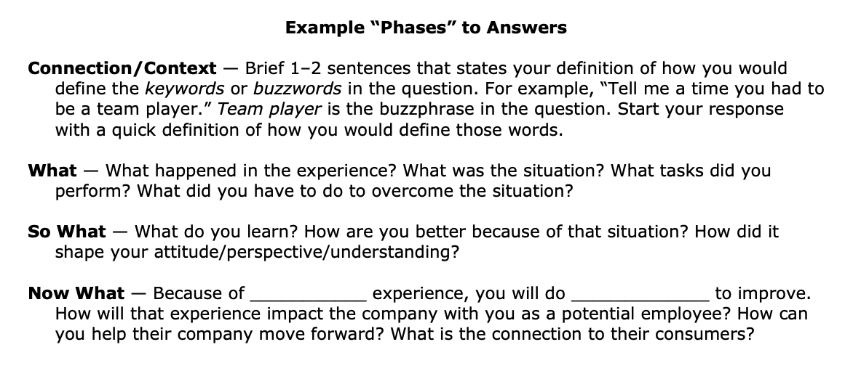
(Norris-Parish 2023)

Slide 10

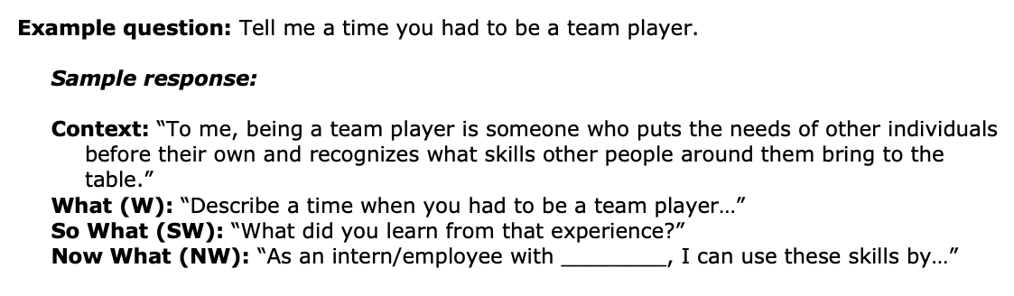
Example Question
(Norris-Parish 2023)

Slide 11
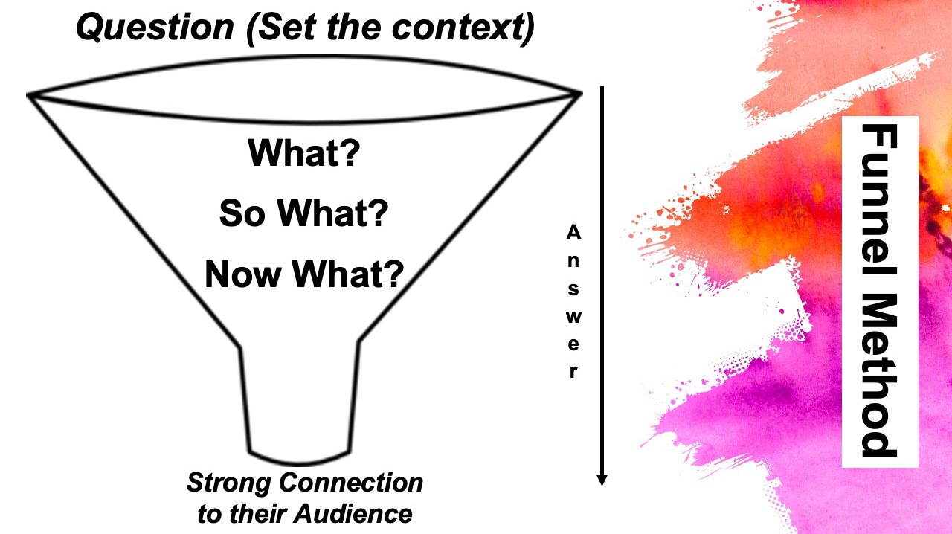
(Norris-Parish 2023)

Slide 12
Round 2: Knowledge Based Test
Tested on 3 aspects
  FFA Knowledge
  Ag Education Knowledge
  Agriculture Knowledge

Slide 13
Round 3: Media Round how well you convey your knowledge to the public
Will be an interview
  Examples:
    TV interview
    Radio Interview
    Podcast interview
Competencies:
Writing Skills
Sincerity
Compassion
Supports and Motivates FFA Members and Partners
Notes:
Do Instagram story activity

Slide 14
Round 4: 1 on 2 Interviews
Two Committee Members ask various questions
5 minute rounds – 6 rounds
Competencies:
Non-verbal communication
Positive Attitude
Sincerity
Compassion
Self Confidence
Notes:
2-1 activity

Slide 15
Round 5: Stand and Deliver
Extemporaneous Speech on Agriculture, FFA, or Ag Education
  Followed by questions on the other two topics
20 minutes for prep, 5-minute speech, 5 minutes for questions
Cut is made after this round
Competencies:
Non-verbal communication
Speaking skills
Ag Knowledge
FFA Knowledge
American Education
Self Confidence
Supports and motivates members/partners
Member Representation
Critical Thinking
Conducting Research
Notes:
Stand and deliver activity

Slide 16
Round 6: Facilitation Practicum
Given a topic and you must prepare the workshop and present 10 minutes of your workshop
50 minutes for prep, 10 minutes for presentation
Workshop 101
Magic Formula
Competencies:
Speaking Skills
Facilitation Skills
Maturity
Initiative
Building Relationships
Notes:
Facilitation overview so they can have homework – magic formula and workshop 101

Slide 17
Day 1 Wrap Up and Homework!!
Notes:
How can we display the qualities of a state officer flipchart and facilitation prep

Slide 18
Facilitation Part 2
Notes:
Delivery and discussion of delivery

Slide 19
Round 7: Round Robin Issues
Rotate the room, read a scenario, and carry out conversations with various individuals based on the presented scenario
35 minutes total
Competencies:
Listening Skills
Positive Attitude
Motivates and Supports Members/Partners
Member Representation
Solve Problems
Critical Thinking
Conducting Research
Notes:
Round robin activity

Slide 20
Round 8: Personal Round 2
Competencies:
Putting Team Before Self
Reliability/Integrity/Trust
Positive Attitude
Sincerity
Compassion
Maturity
Coachable/Life-long Learning
Commitment to Service
Mentors and Coaches Others
A final personal interview to allow nom-com to get to know you more in depth
10 minutes
Notes:
Answer one question in front of group

Slide 21
Review
Questions?
Notes:
What are the qualities… flipcharts

